Slide 1

Sentiment Analysis & Topic Modeling Mobile Application (SentiScope)
Project members:
Avanish Jha CB.EN.U4ELC20011
Ratneshwar Bharti CB.EN.U4ELC20056
Ravi Gupta CB.EN.U4ELC20057
Rudraksh Singh CB.EN.U4ELC20060
Guided by:
Mr. R Ranjith
Assistant Professor
EEE Dept.

Slide 2

Significance
Data-Driven Decisions: Real-time sentiment insights guide businesses.
Customer Engagement: Address sentiments for better loyalty.
Crisis Prevention: Detect negative trends early.
Tech Integration: Showcasing the synergy of Flutter, Firebase, and ML.

Slide 3

Objective
To understand the demand for sentiment analysis tools.
Real-time feedback and insights for users.
Enhancing business decisions through user feedback analysis.
Creation of a mobile application integrating sentiment analysis and topic modeling.

Slide 4
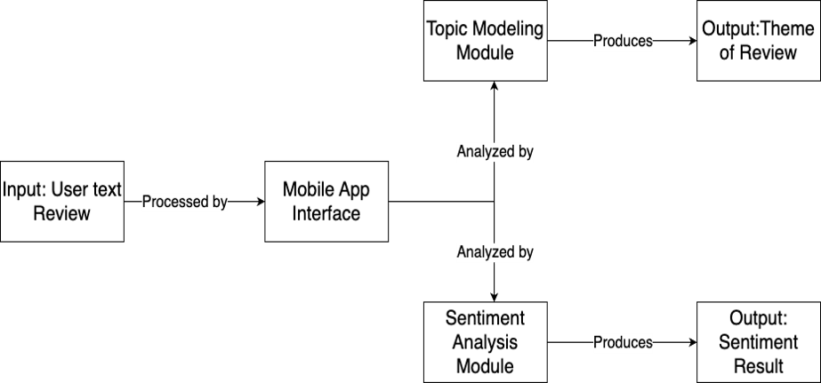
Project Block Diagram

Slide 5
Random Forest:
Overview:
Ensemble learning method that builds multiple decision trees and merges them.
Reduces overfitting and increases accuracy by averaging results.
Applications:
Robust performance in sentiment analysis due to its ensemble nature.
Suitable for handling large and diverse datasets.

Slide 6

Data Preparation and Cleaning
Loading the Data:
Mounted Google Drive and loaded a dataset named "Reviews.csv" using Pandas.
Displayed the first few rows and identified the columns in the dataset.
Data Cleaning:
Remove Duplicates:
Deduplicated the dataset to eliminate redundant data.
Handle Missing Values:
Checked for missing values and removed rows with missing text data.
Text Pre-processing:
Convert to Lowercase:
Lowercased the text in the 'Text' column.
Remove Punctuations, Numbers, and Special Characters:
Utilized regular expressions to clean text data.
Tokenize the Text and Remove Stopwords:
Tokenized the text and removed common English stopwords.
Stemming:
Applied stemming to reduce words to their root form for simplicity.

Slide 7

Labeling, Feature Extraction, and Model Loading
Labeling:
Defined sentiment labels based on the 'Score' attribute.
Created a new column 'Sentiment' to represent Positive, Neutral, and Negative sentiments.
Feature Extraction & Splitting the Dataset:
Text Vectorization:
Used TF-IDF vectorization to convert text data into numerical features.
Encoding the Sentiment Labels:
Converted sentiment labels into numerical format for model training.
Model Loading:
Loaded pre-trained machine learning models (Logistic Regression, Gradient Boosting, Random Forest, Support Vector Machine) and vectorizer from saved files.

Slide 8
Model Overview and Evaluation
Model Overview:
Mentioned the use of multiple machine learning models for sentiment analysis.
Highlighted the importance of text pre-processing and feature extraction.
Model Evaluation:
Mentioned the splitting of the dataset into training and test sets.
Highlighted the need for model evaluation using metrics like accuracy, precision, recall, and F1 score.
Conclusion:
Summarized the entire process, from data loading to model loading.
Emphasized the significance of preprocessing and model selection in sentiment analysis.

Slide 9
Model Comparison
Accuracy:
Random Forest: 89.50%
Logistic Regression: 86.27%
SVM: 86.15%
Gradient Boosting: 81.91%
Precision:
Random Forest: 90.06%
Logistic Regression: 84.07%
SVM: 83.98%
Gradient Boosting: 80.14%
Recall:
Random Forest: 89.50%
Logistic Regression: 86.27%
SVM: 86.15%
Gradient Boosting: 81.91%
F1-Score:
Random Forest: 88.15%
Logistic Regression: 84.35%
SVM: 83.60%
Gradient Boosting: 76.74%

Slide 10
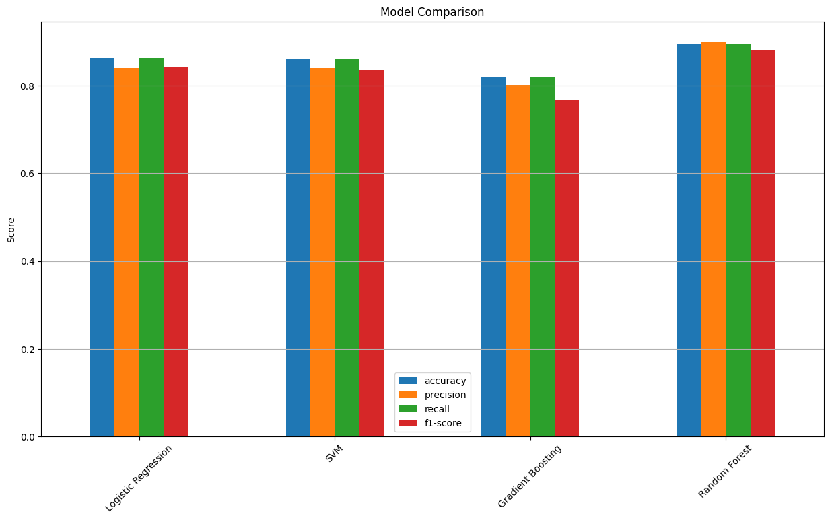

Slide 11
Analysis:
Random Forest emerges as the best-performing model across all metrics.
Logistic Regression and SVM show similar performance.
Gradient Boosting lags behind, especially in precision and recall.
Consider Random Forest for high-precision sentiment analysis.

Slide 12
Considering LLM
High Computational Resources: Developing LLMs requires significant computational power. Training such models often involves using hundreds or even thousands of high-end GPUs or TPUs for weeks or months, which is extremely expensive and resource-intensive.
Large Dataset Requirements: LLMs are trained on vast datasets, often requiring billions of words. Collecting, storing, and processing such a massive dataset is a daunting task. It requires substantial infrastructure and raises concerns about data quality and representativeness.

Slide 13
Conclusion:
Our sentiment analysis project demonstrates Random Forest's superior performance in accuracy, precision, recall, and F1-score. Logistic Regression and SVM offer a balanced trade-off, while Gradient Boosting lags behind. Visualization of confusion matrices and feature importance aids in model understanding. Recommendations include choosing Random Forest for high-precision analysis and Logistic Regression or SVM for a balanced approach

Slide 14
Time Frame
Month (2023-24) | Task to be Completed
September 2023 | Literature survey
Early October 2023 | Define requirements for sentiment analysis and topic modeling models. Research NLP libraries.
Mid-Late October 2023 | Set up the development environment for model training. Prepare training data.
Early November 2023 | Build and train the sentiment analysis model with prepared data. Evaluate performance.
Mid-November 2023 | Experiment with different Sentiment Analysis Model Classifiers and choose the best one for our project.

Slide 15
Time Frame
Month (2023-24) | Task to be Completed
December 2023 | Fine-tune sentiment analysis model.
Early January 2024 | Creation of Figma UI Design for the overall structure of the app.
Mid-January 2024 | Finalize sentiment analysis model and deploy it on chosen cloud platform (Google Cloud or AWS).
February 2024 | Flutter App Development. Integration to cloud models
March 2024 | Develop and Train Topic Modeling Model
April 2024 | Debugging and Testing of the Application.

Slide 16
References
[1] S. T. K. Shivaprasad and J. Shetty, "Sentiment Analysis of Product Reviews: A Review," NMAM Institute of Technology Nitte, 2017. [Online]. Available: https://doi.org/10.1109/ICICCT.2017.7975207
[2] M. Mashaabi, A. Alotaibi, H. Qudaih, R. Alnashwan, and H. Al-Khalifa, "Natural Language Processing in Customer Service: A Systematic Review," King Saud University, Riyadh, 2022. [Online]. Available: https://doi.org/10.48550/arXiv.2212.09523
[3] G. Kaur and A. Sharma, "Comparison of Different Machine Learning Algorithms for Sentiment Analysis," Symbiosis International University, Pune, 2022. [Online]. Available: https://doi.org/10.1109/ICSCDS53736.2022.9760846
[4] D. Khurana, A. Koli, K. Khatter, and S. Singh, "Natural language processing: state of the art, current trends, and challenges," 2022. [Online]. Available: https://doi.org/10.1007/s11042-022-13428-4
[5] G. Papadia, M. Pacella, M. Perrone, and V. Giliberti, "A Comparison of Different Topic Modeling Methods through a Real Case Study of Italian Customer Care," Algorithms, vol. 16, no. 94, 2023. [Online]. Available: https://doi.org/10.3390/a16020094

Slide 17
[6] P. Dhanalakshmi, G. A. Kumar, B. S. Satwik, K. Sreeranga, A. T. Sai and G. Jashwanth, "Sentiment Analysis Using VADER and Logistic Regression Techniques," 2023 International Conference on Intelligent Systems for Communication, IoT and Security (ICISCoIS), Coimbatore, India, 2023, pp. 139-144, doi: 10.1109/ICISCoIS56541.2023.10100565.
[7] Wankhade, M., Rao, A.C.S. & Kulkarni, C. A survey on sentiment analysis methods, applications,and challenges. Artif Intell Rev 55, 5731–5780 (2022). https://doi.org/10.1007/s10462-022-10144-1

